Slide 1
3. Fairness: Definitions and metrics

Slide 2

What is fairness ?
Many definitions of fairness:
Individual. seeks for similar individuals to be treated similarly
Group. split a population into groups defined by protected attributes (e.g. women, black) and seeks for some measure to be equal across groups

Slide 3

Individual fairness
Am I as an individual being treated as another with similar qualifications?
Fairness through unawareness.
Fairness through awareness.
Counterfactual fairness.

Slide 4
Fairness through unawareness
Definition: Protected attributes A not explicitly used as features X.
Mathematically: A∩X = ∅
Potential problem: proxy in the data (see practice notebook).

Slide 5
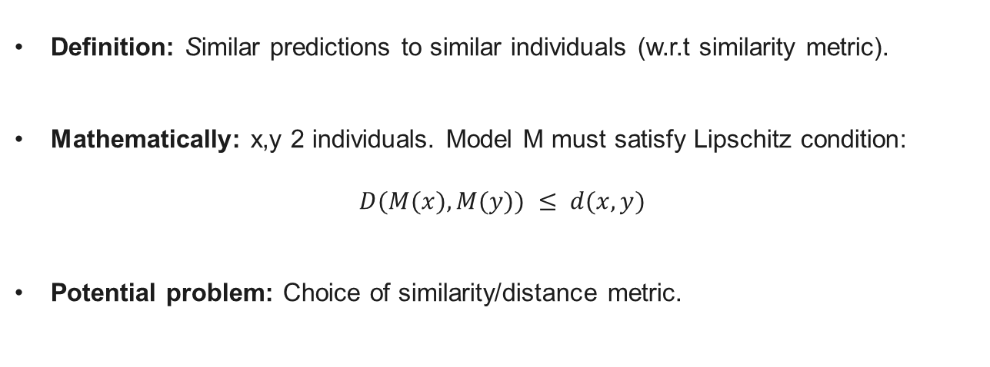
Fairness through awareness/ Individual Fairness
Definition: Similar predictions to similar individuals (w.r.t similarity metric).
Mathematically: x,y 2 individuals. Model M must satisfy Lipschitz condition:
$$D(M(x),M(y)) ≤ d(x,y)$$
Potential problem: Choice of similarity/distance metric.

Slide 6
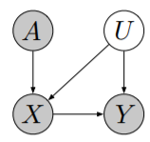
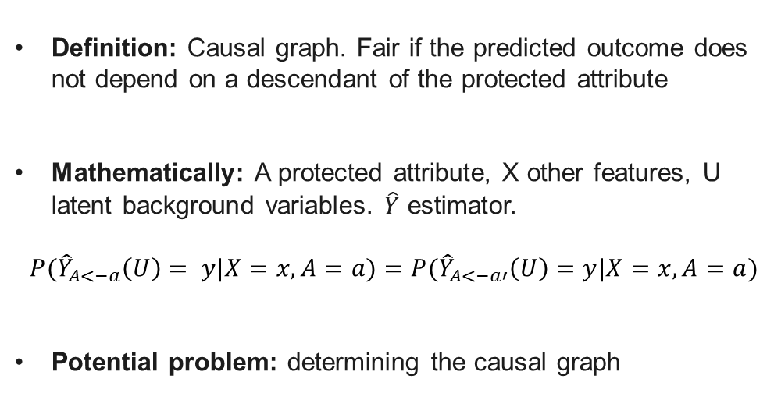
Race
Aggressive driving
Counterfactual fairness
Definition: Causal graph. Fair if the predicted outcome does not depend on a descendant of the protected attribute
Mathematically: A protected attribute, X other features, U latent background variables. $\hat{Y}$ estimator.
$$P({\hat{Y}}_{A<−a}\left(U\right)= y|X=x,A=a)=P({\hat{Y}}_{A<−a′}\left(U\right)=y|X=x,A=a)$$
Potential problem: determining the causal graph
Like red cars
Accident rate

Slide 7

Group fairness
Is the minority group to which I belong being treated as the majority group?
Equality of Outcome. Distribution across groups should be the same (Statistical Parity, Disparate Impact)
Equality of Opportunity. E.g. Equalized Odds

Slide 8


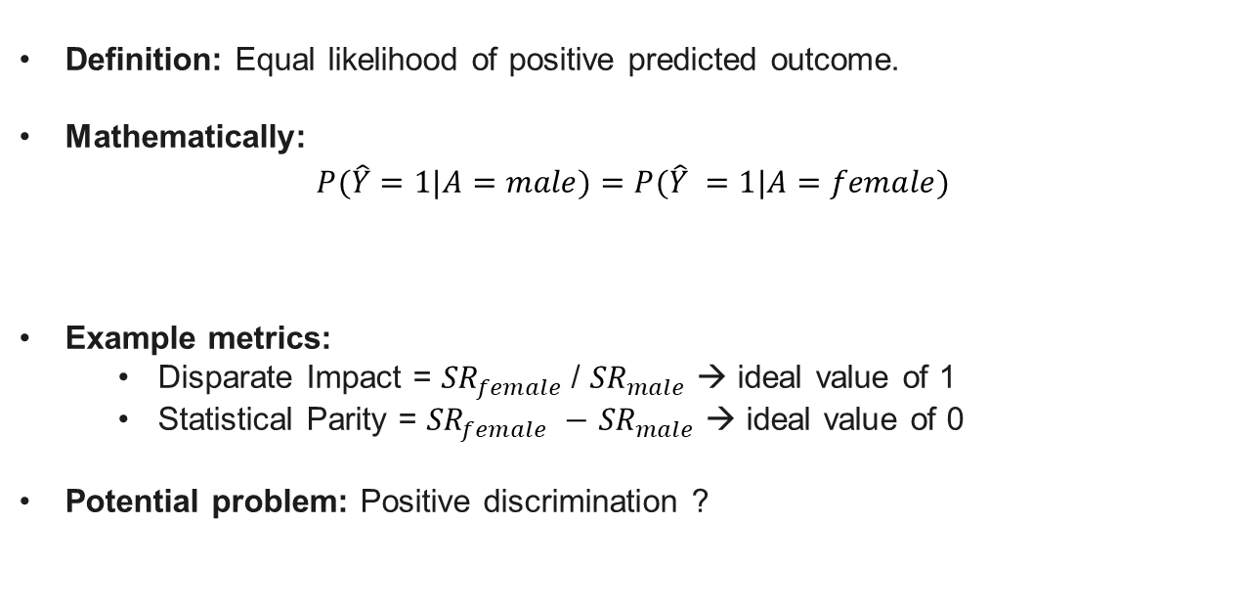
Equality of Outcome
Definition: Equal likelihood of positive predicted outcome.
Mathematically: $P(\hat{Y}=1|A=male)=P(\hat{Y} =1|A=female)$
Example metrics:
Disparate Impact = ${SR}_{female}$/ ${SR}_{male}$ → ideal value of 1
Statistical Parity = ${SR}_{female} −$ ${SR}_{male}$ → ideal value of 0
Potential problem: Positive discrimination ?
$${SR}_{male}$$
$${SR}_{female}$$

Slide 9

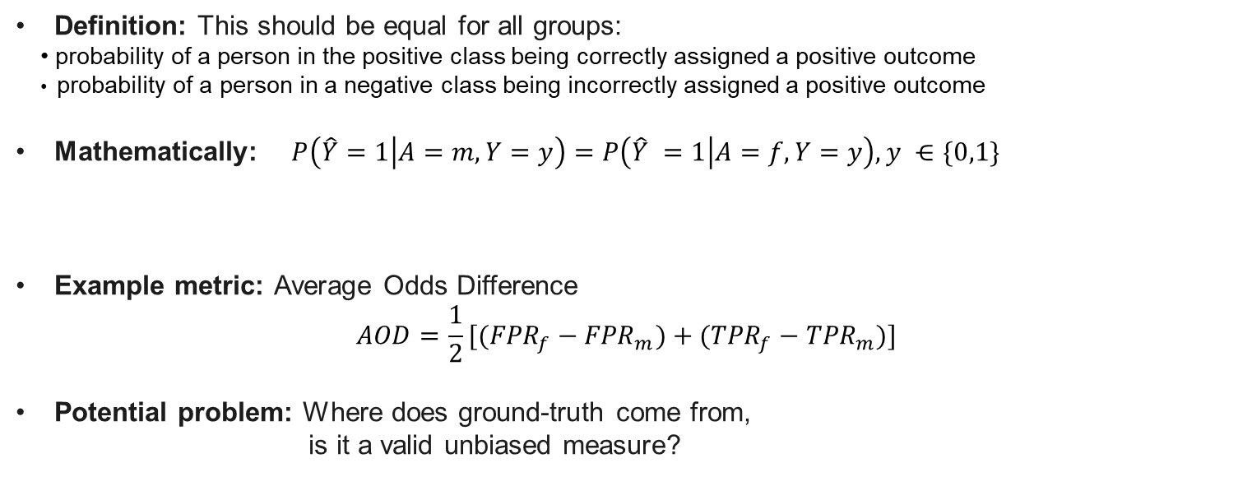
Equality of Opportunity
Definition: This should be equal for all groups:
probability of a person in the positive class being correctly assigned a positive outcome
probability of a person in a negative class being incorrectly assigned a positive outcome
Mathematically: $P\left(\hat{Y}=1 | A=m,Y=y\right)=P\left(\hat{Y} =1 | A=f,Y=y\right), y ⋲\{0,1\}$
Example metric: Average Odds Difference
$$AOD=\frac{1}{2}[({FPR}_{f}−{FPR}_{m})+({TPR}_{f}−{TPR}_{m})]$$
Potential problem: Where does ground-truth come from,
is it a valid unbiased measure?
${TPR}_{m}$ if $y =1$; ${FPR}_{m}$ if $y =0$

Slide 10
Group fairness - Illustration through an example

Slide 11
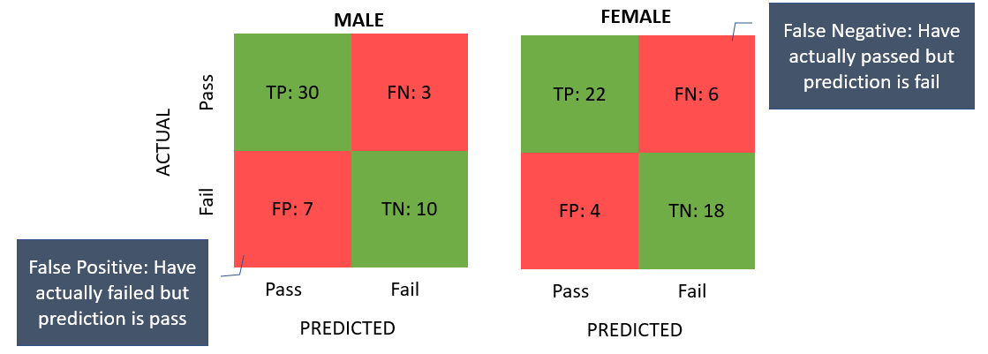

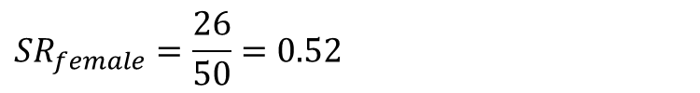

Equality of outcome →
$$P(\hat{Y}=1|A=male)=P(\hat{Y} =1|A=female)$$
$${SR}_{male}=37/50=0.74$$
$$SP=0.52−0.74=−0.22$$
$${SR}_{female}=\frac{26}{50}=0.52$$
DI $=0.52/0.74=0.7$

Slide 12


Equality of opportunity →
$$P\left(\hat{Y}=1 | A=male,Y=0\right)=P\left(\hat{Y} =1 | A=female,Y=0\right)$$
Y = 0
$$\hat{Y}=1 | Y=0$$
$P\left(\hat{Y}=1 | A=m,Y=0\right)$ = ${FPR}_{male}$= $\frac{FP}{FP+TN}$ = 7/17 = 0.41
$P\left(\hat{Y}=1 | A=f,Y=0\right)$ = 4/22 = 0.18

Slide 13


Equality of opportunity →
$$P\left(\hat{Y}=1 | A=male,Y=1\right)=P\left(\hat{Y} =1 | A=female,Y=1\right)$$
Y = 1
$$\hat{Y}=1 | Y=1$$
$P\left(\hat{Y}=1 | A=m,Y=1\right)$ = ${TPR}_{male}$= $\frac{TP}{TP+FN}$ = 30/33 = 0.91
$P\left(\hat{Y}=1 | A=f,Y=1\right)$ = 22/28 = 0.79

Slide 14
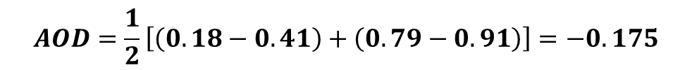
Average Odds Difference
$$AOD=\frac{1}{2}\left[\left(0.18−0.41\right)+\left(0.79−0.91\right)\right]=−0.175$$

Slide 15
Reading/References
Supporting Notebook
Definitions of fairness
(Verma & Rubin, 2018) Fairness Definitions Explained
(Mehrabi et al., 2021). A survey on bias and fairness in machine learning
Metrics
https://aif360.mybluemix.net/

